Slide 1

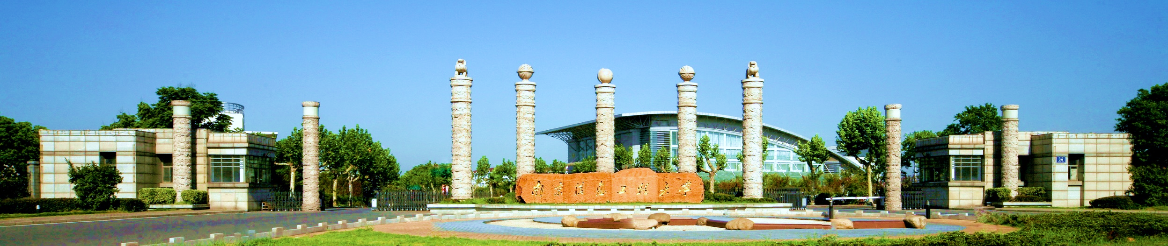
Principles of communications
Chapter 3 Channel—Part I

Slide 2
Chapter 3: Channel — Part I
3.1 The classification of channels 信道的分类
--Wireless channels 无线信道
--Wire channel 有线信道
3.2 Channel models 信道模型
--Modulation channel model（调制解调模型）
--Coding channel model（编码信道模型）
3.3 Influence of the channel characteristics on transmission (for modulation model)信道特性对传输的影响
3.4 Channel capacity (continuous channel) 信道容量

Slide 3
3.1 The classification of channels 信道的分类
We may classify communication channels in different ways:
Wired channel：有线信道
Wireless channel：无线信道
Transmitted media
Constant parameter channel
Random parameter channel
Channel
characteristic
恒参信道
随参信道

Slide 4
3.1 The classification of channels 信道的分类
Wired channel：有线信道
Wireless channel：无线信道
Transmitted media
Wired channel: guided propagation
--symmetrical cable: （对称电缆）
--coaxial cable（同轴电缆）
--optical fiber （光纤）
Wireless channel: based on free propagation
--ground wave
--sky wave
--LOS (line of sight) 视距

Slide 5
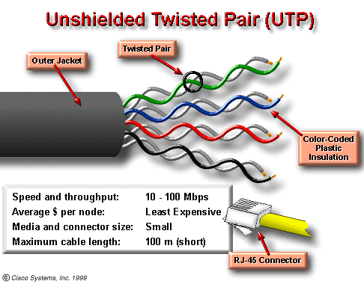
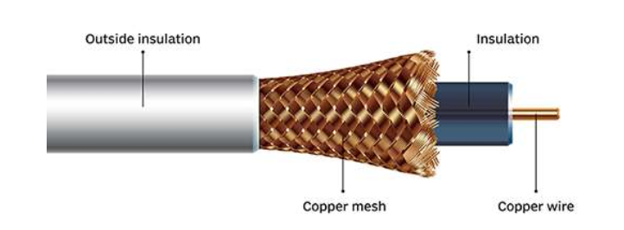
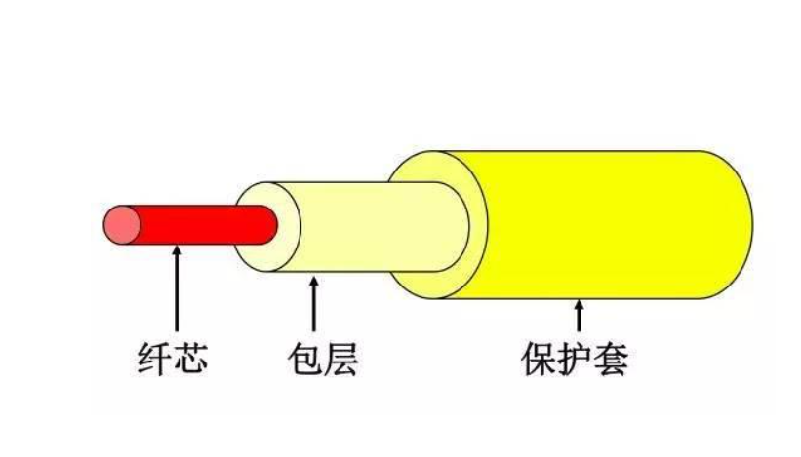
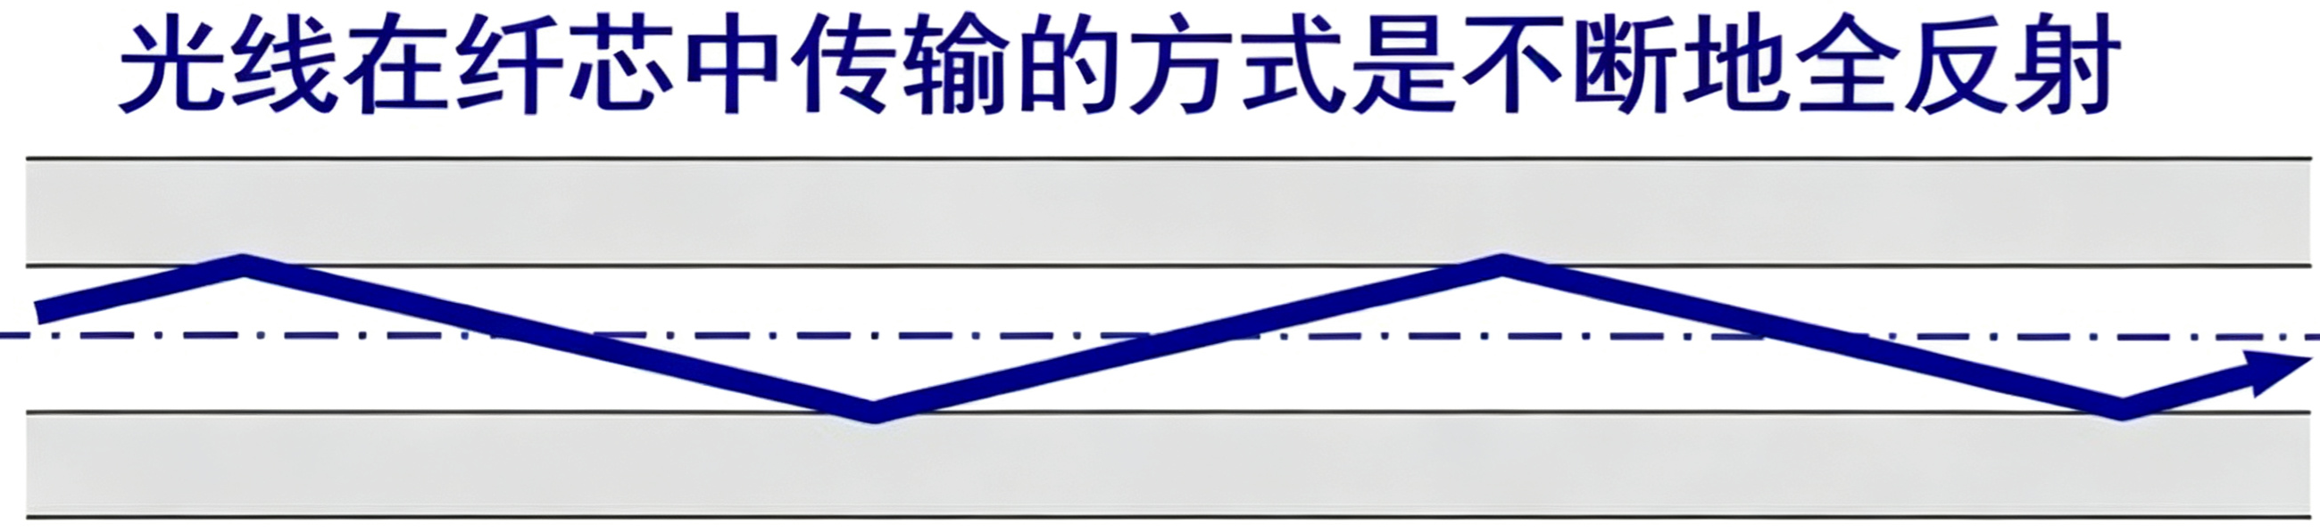
3.1 The classification of channels 信道的分类
Wired channel: guided propagation
--symmetrical cable: twist wire
--coaxial cable（同轴电缆）
--optical fiber （光纤）
电信号
天才简史：高锟（光纤之父）
前香港中文大学校长高锟和George A. Hockham首先提出光纤可以用于通讯传输的设想，高锟因此获得2009年诺贝尔物理学奖。
光信号

Slide 6
3.1 The classification of channels
Wired channel: based on guided propagation
- symmetrical cable
-coaxial cable
-optical fiber
Wireless channel: based on free propagation
-ground wave
-sky wave
-LOS (Line of Sight)

Slide 7
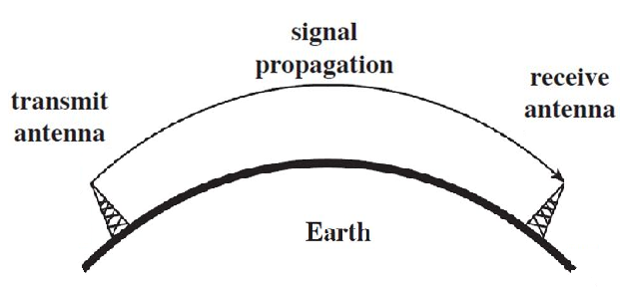
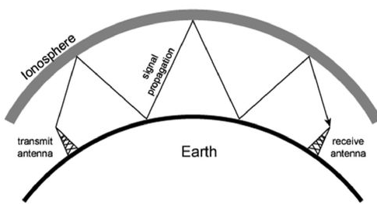
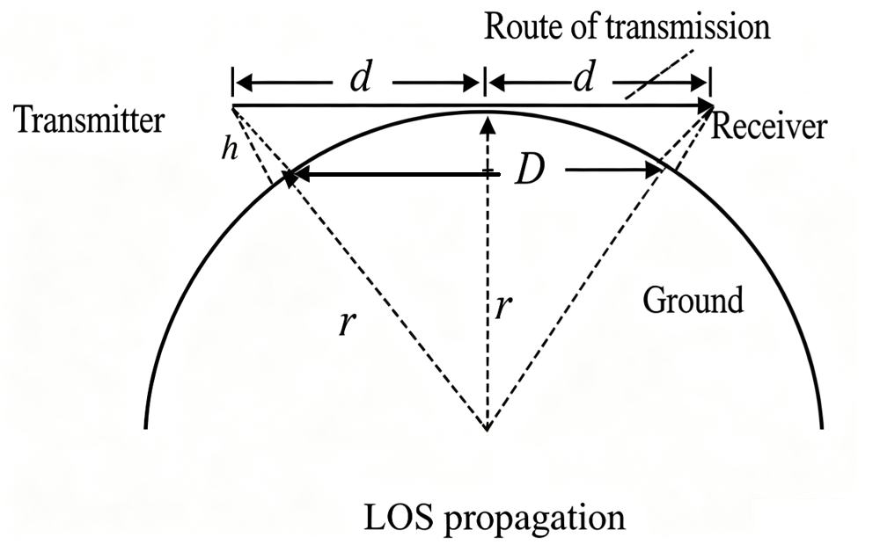
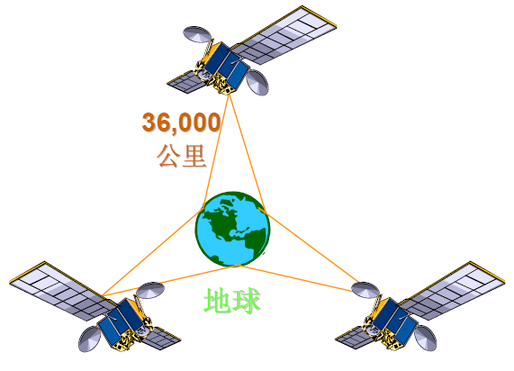
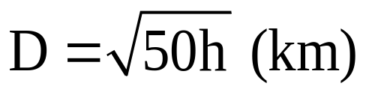
Wireless channel: based on free propagation
--ground wave
--sky wave
--LOS (Line of Sight)
< 2MHz
Over hundreds to
thousands of km
2~30MHz
10000km
短波电台
>30MHz

Slide 8
Summary
Wired Channel（有线信道）
① Twisted-pair cable：Low cost, used for short-range LAN. Vulnerable to electromagnetic crosstalk.
成本低，短距离局域网（网线），易受干扰。
② Coaxial cable：Better anti-interference performance than twisted pair; used in old CATV and surveillance systems.
抗干扰优于双绞线，早期有线电视、监控。
③ Optical fiber：Excellent anti-interference, huge bandwidth, long transmission distance. Used for backbone & long-haul communication.
抗干扰极强、带宽大、远距离，骨干网、长途通信。

Slide 9
Summary
Wireless Channel（无线信道）
① Ground wave：Propagates along the Earth’s surface. Suitable for long-distance medium & long wave; capable of diffracting around surface obstacles.
沿地球表面传播，适合长距离、中长波，可绕过地表障碍物。
② Sky wave：Reflected by the ionosphere. Uses short waves for long-distance, intercontinental communication.
利用电离层反射传播，短波，可实现远距离、跨大洲通信。
③ Line-of-Sight (LOS) propagation：Microwave travels in straight line with no obstruction between two points. Applications: base stations, satellites, wireless bridges.
视线传播：微波，两点之间无遮挡，直线传输（基站、卫星、无线网桥）。

Slide 10
Matching Question
Channels
symmetrical cable
coaxial cable
optical fiber
ground wave
sky wave
LOS (line of sight)
Applications
Long-distance high-speed backbone transmission
B. Home telephone and short-
distance LAN
C. Cable television (CATV)
D. Microwave relay, point-to-point
LOS transmission
E. Medium wave radio broadcasting
F. Shortwave over-the-horizon long-
distance radio

Slide 11
Example 1
Assume a wireless link uses line-of-sight propagation for communication, and the heights of the transmitting antenna and the receiving antenna are both 80m.Find the maximum communication distance.

Slide 12
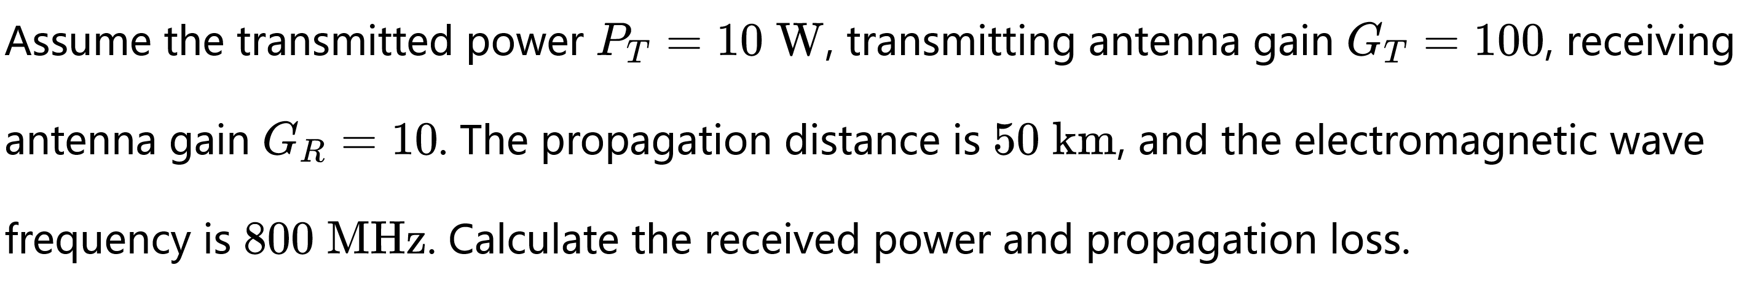
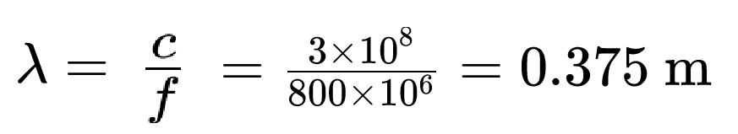
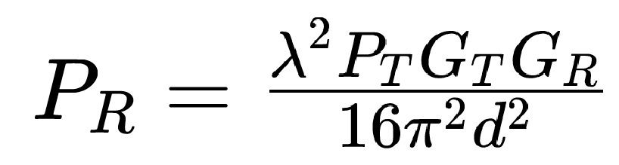
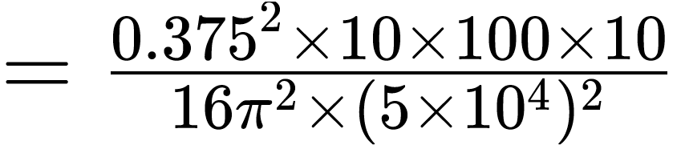
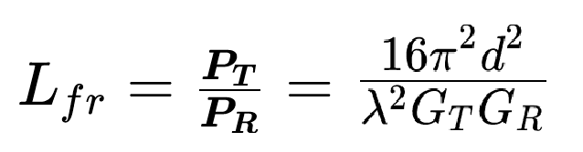
Example 2
理想自由空间传播衰落模型(Friis方程)

Slide 13
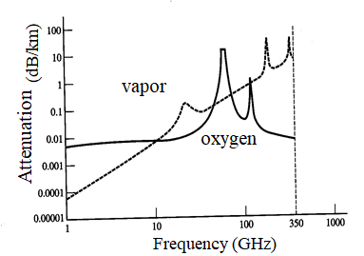
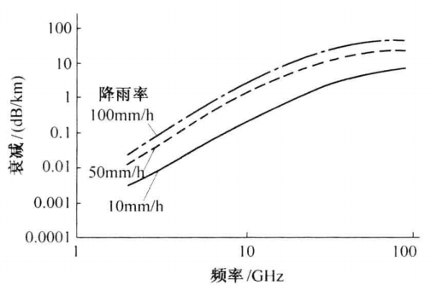
Wireless channel: based on free propagation
350GHz
62GHz
180GHz
23GHz
120GHz
Attenuation characteristics of the atmosphere

Slide 14
Chapter 3: Channel — Part I
3.1 The classification of channels 信道的分类
--Wireless channels 无线信道
--Wire channel 有线信道
3.2 Channel models 信道模型
--Modulation channel model（调制解调模型）
--Coding channel model（编码信道模型）
3.3 Influence of the channel characteristics on transmission
信道特性对传输的影响
3.4 Channel capacity (continuous channel) 信道容量

Slide 15
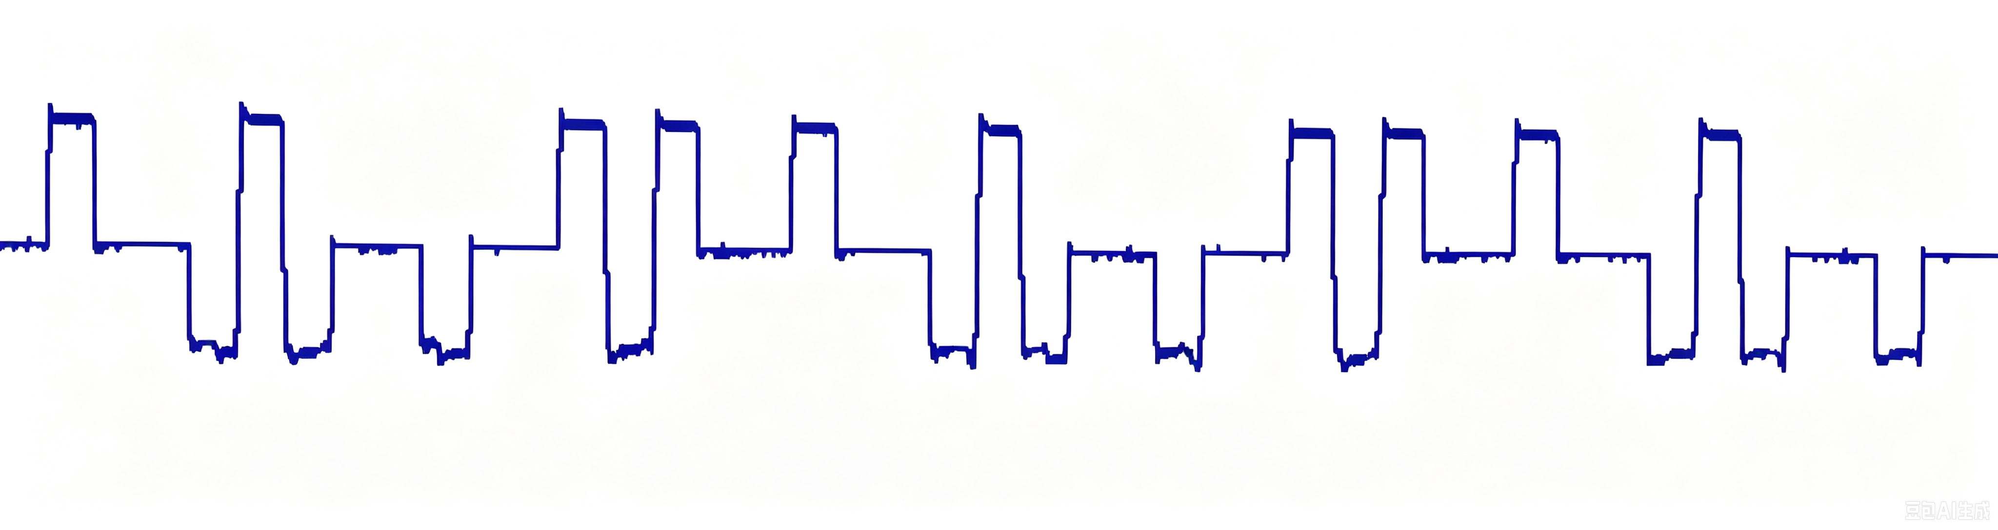
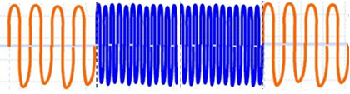
3.2 Channel models 信道模型
--Modulation channel model（调制解调模型）
--Coding channel model（编码信道模型）
Source of information
User of information
Source encoder
Source decoder
Encryption
Decryption
Channel encoder
Channel decoder
Modulator
Demodulator
channel
Noise
Modulation channel
Coding channel

Slide 16
3.2 Channel models 信道模型
--Modulation channel model（调制解调模型）
--Coding channel model（编码信道模型）
Source of information
User of information
Source encoder
Source decoder
Encryption
Decryption
Channel encoder
Channel decoder
Modulator
Demodulator
channel
Noise
Modulation channel
Coding channel

Slide 17
3.2 Channel models 信道模型
--Modulation channel model（调制解调模型）
--Coding channel model（编码信道模型）
Source of information
User of information
Source encoder
Source decoder
Encryption
Decryption
Channel encoder
Channel decoder
Modulator
Demodulator
channel
Noise
Modulation channel
Coding channel

Slide 18
3.2 Channel models 信道模型
--Modulation channel model（调制解调模型）
--Coding channel model（编码信道模型）
The modulation channel is a real physical channel,
while the coding channel is merely an abstract model with statistical properties.
调制信道是真实物理信道，而编码信道仅仅是具有统计特性的抽象模型

Slide 19
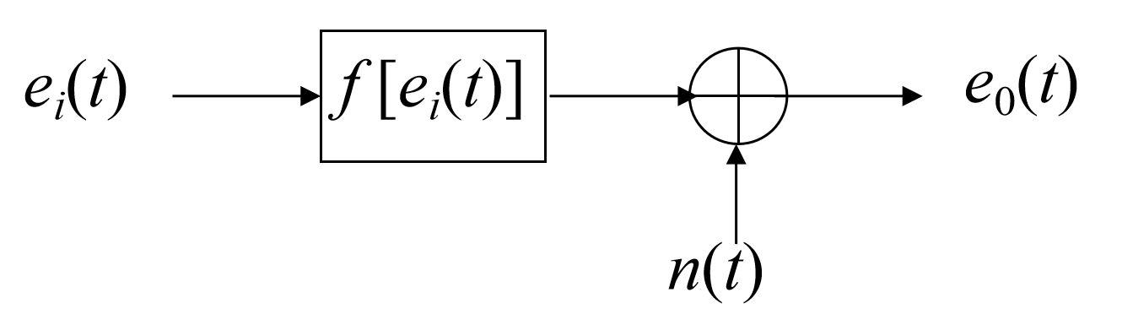
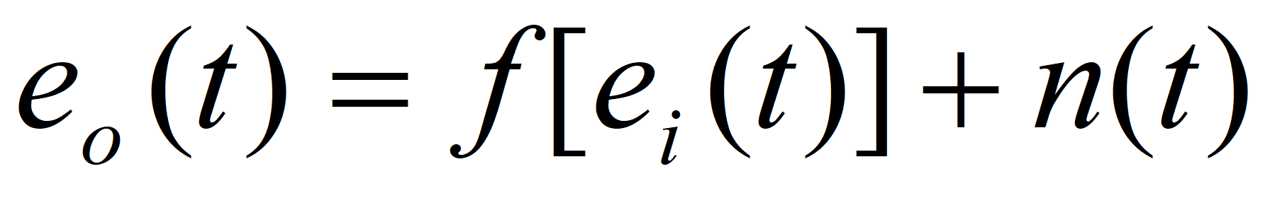
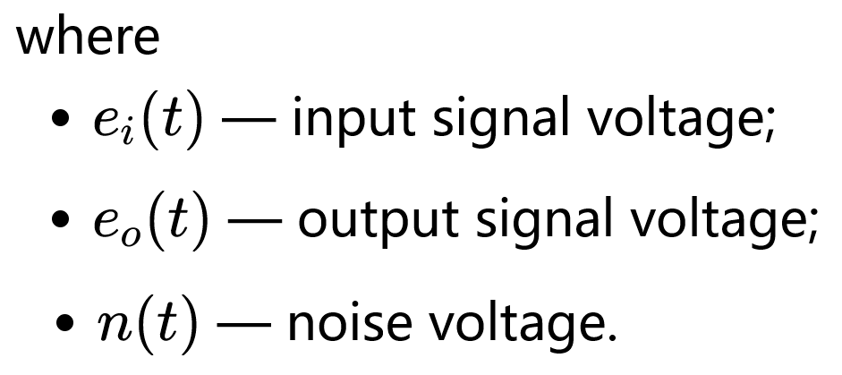
3.2 Channel models 信道模型
--Modulation channel model（调制解调模型）

Slide 20
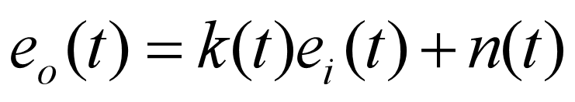
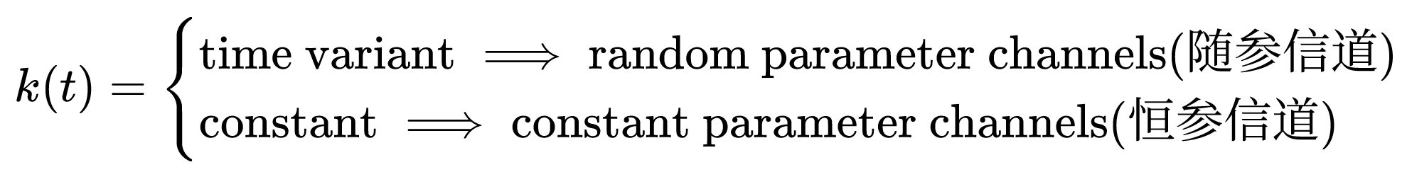
3.2 Channel models 信道模型
--Modulation channel model（调制解调模型）
Constant parameter channels（恒参信道）
Wire line（有线电话线）
Coaxial cable（同轴电缆）
Optical fiber（光纤）
Microwave line-of-sight（视距微波）
Random parameter channels（随参信道）
Shortwave ionospheric channel（短波电离层）
Mobile radio channel（移动通信无线信道）
Troposcatter channel（对流层散射信道）

Slide 21
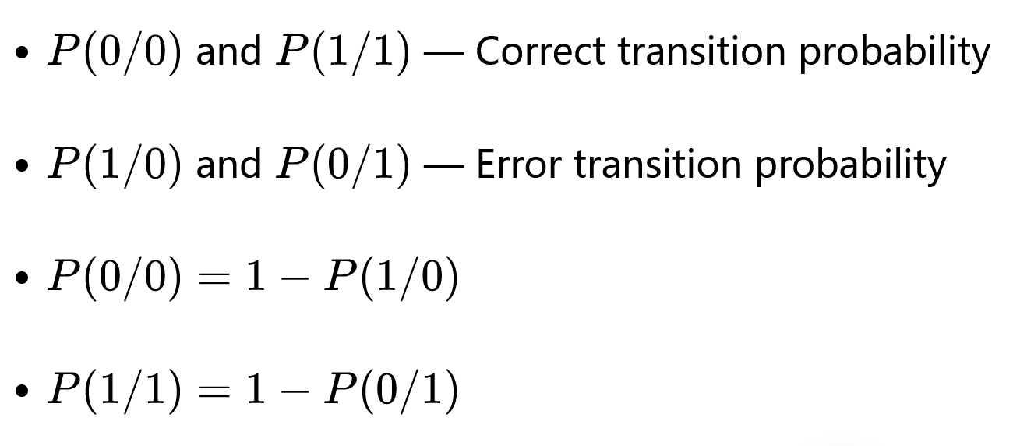
3.2 Channel models 信道模型
--Coding channel model
P(0 / 0)
0
0
P(1 / 0)
Transmitter
Receiver
P(0 / 1)
1
1
P(1 / 1)
Binary coding channel model — Memoryless model
转移概率

Slide 22
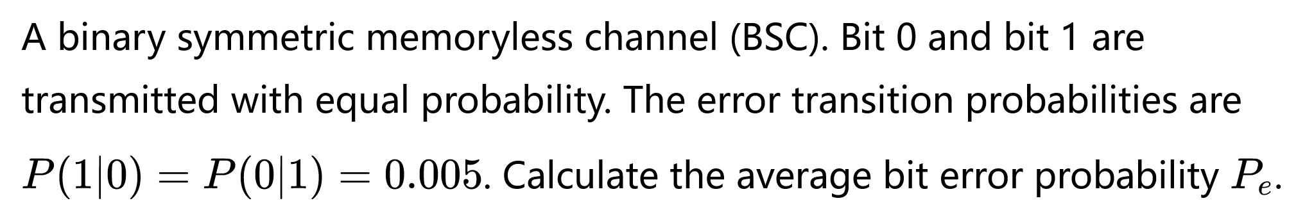
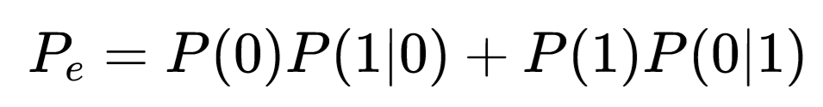
Example 3
P(0 / 0)
0
0
P(1 / 0)
Transmitter
Receiver
P(0 / 1)
1
1
P(1 / 1)

Slide 23
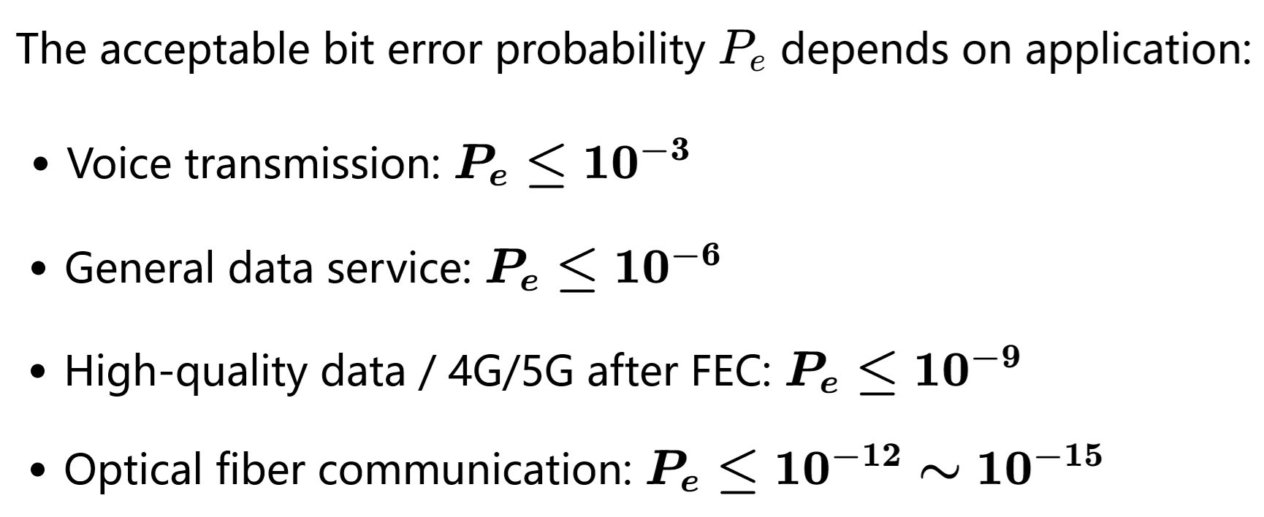

Slide 24

3.2 Channel models 信道模型
--Coding channel model（编码信道模型）
0
0
$p(y_{k}/$ $x_{j})$
Transition probability
Transmitter
1
1
Receiver
X
Y
2
2
3
3
Quaternary coding channel model

Slide 25
Example
( ) 1. The modulation channel is located between the output of the modulator and the input of the demodulator.
( )2. The coding channel mainly analyzes waveform distortion and amplitude-frequency distortion of analog signals.
( ) 3. The performance of the coding channel depends on the noise and distortion from the modulation channel.
What is the difference between modulation channel and coding channel?

Slide 26
Chapter 3: Channel — Part I
3.1 The classification of channels 信道的分类
--Wireless channels 无线信道
--Wire channel 有线信道
3.2 Channel models 信道模型
--Modulation channel model（调制解调模型）
--Coding channel model（编码信道模型）
3.3 Influence of the channel characteristics on transmission
信道特性对传输的影响
--Influence of Constant parameter channels on transmission
--Influence of Random parameter channels on transmissio

Slide 27
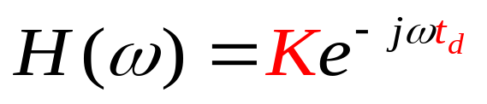
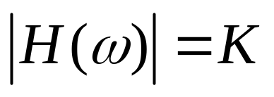
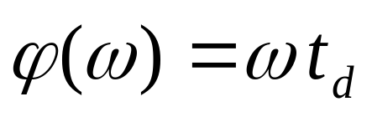
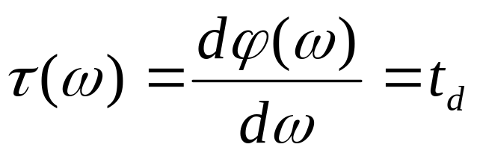
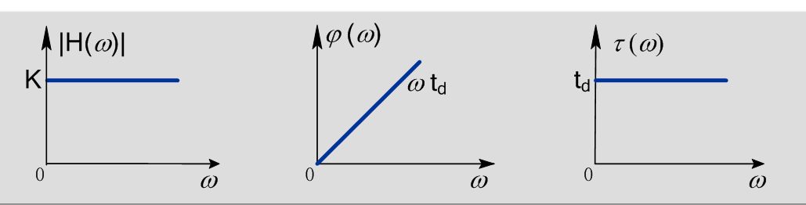
3.3 Influence of the channel characteristics on transmission
Ideal constant parameter channel transmission characteristics
Amplitude-frequency characteristic：
Phase-frequency characteristic：
Or Group delay（群延时）:

Slide 28
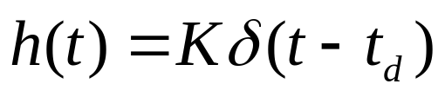
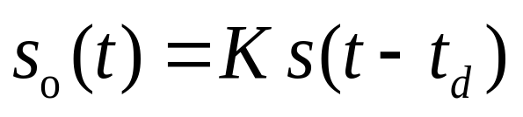
3.3 Influence of the channel characteristics on transmission
Ideal constant parameter channel transmission characteristics
  If the input signal is s(t), then output is:
constant time delay
constant attenuation
—— This case is called distortionless transmission.
无失真传输

Slide 29
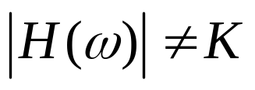
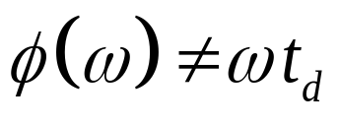
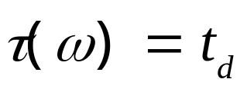
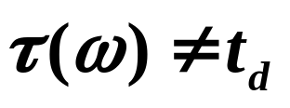
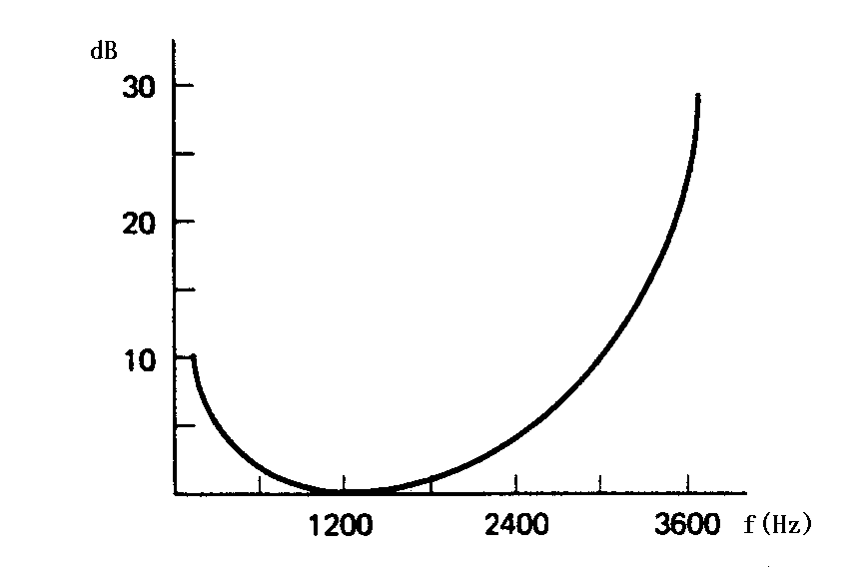
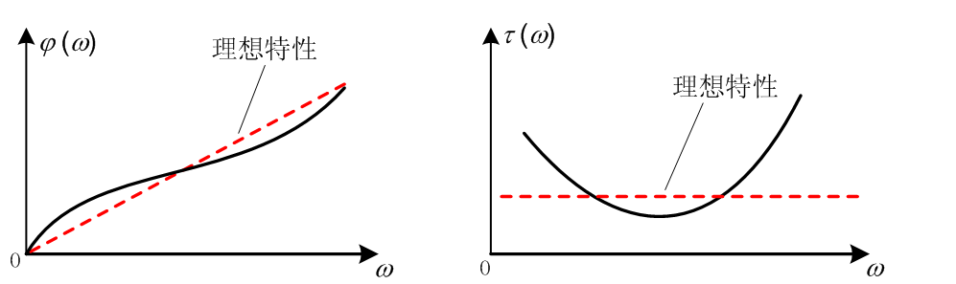

3.3 Influence of the channel characteristics on transmission
Practical constant parameter channel are not ideal
In practice
Typical telephone channel:
Linear compensation network
线性补偿网络
$$\left|\left.H(ω\right)\right|$$
Insertion loss插入损耗
Decrease of SNR and increase ISI ( Inter-symbol interference)

Slide 30
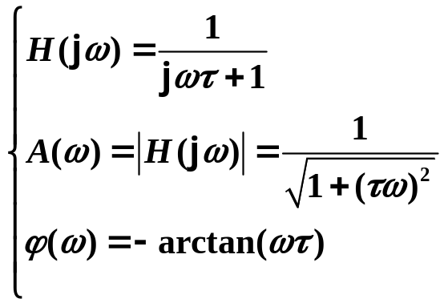
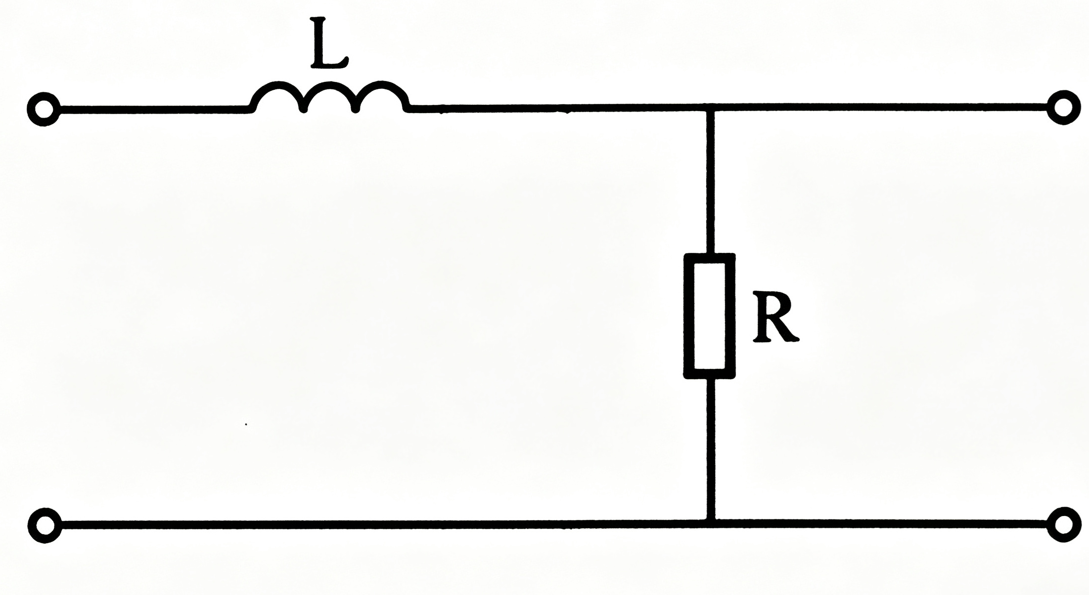
3.3 Influence of the channel characteristics on transmission
Practical constant parameter channel are not ideal
Example: The equivalent model of a constant parameter channel is shown in the following Figure. Analyze what kinds of distortion will occur when the signal transmits through this channel.

Slide 31
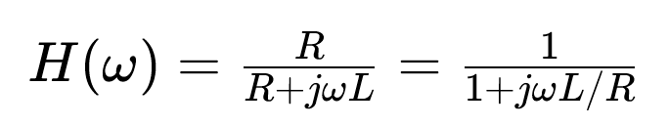
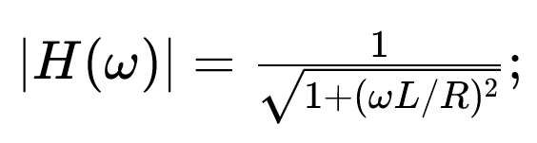
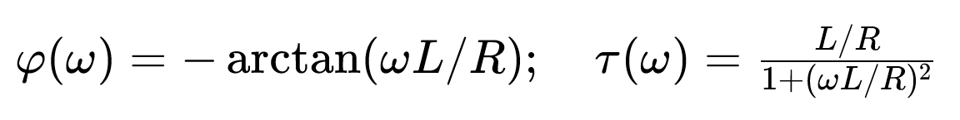
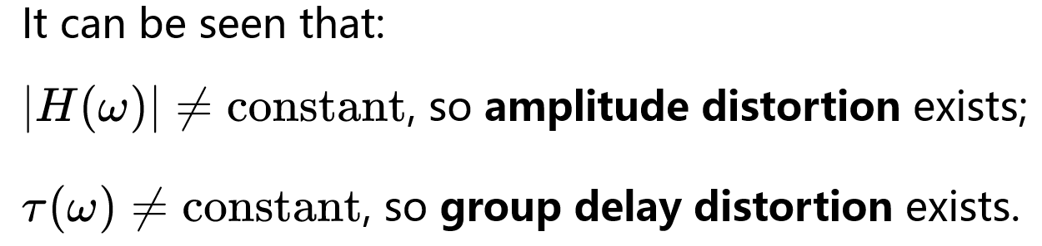
3.3 Influence of the channel characteristics on transmission
Practical constant parameter channel are not ideal
Solution The transfer function of this channel is:

Slide 32
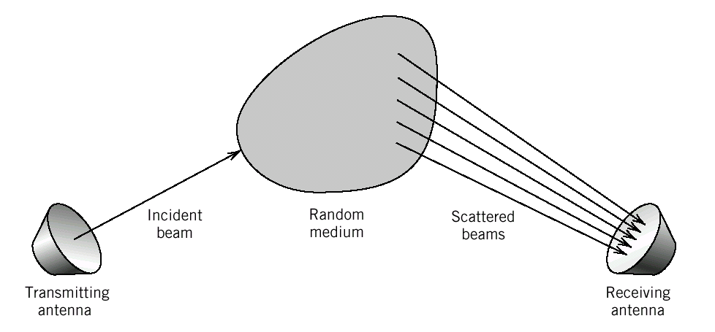
3.3 Influence of the channel characteristics on transmission
--Influence of Random parameter channels on transmission
Three characteristics:
Transmission attenuation of the signal is varying with time;
Transmission delay of the signal varies with time;
Signal arrives at the receiver over several paths, i.e. multi-path propagation(多径传播)phenomenon exists.
Most wireless channels belong to random parameter channels.

Slide 33
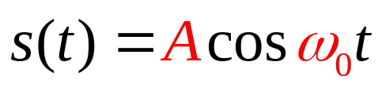
Influence of Random parameter channels on transmission
--Multipath effect(多径效应):
The effect of multipath propagation on signals.
?
Constant amplitude
&single frequency
Figure. 3.3.3 Model of a multipath channel.

Slide 34
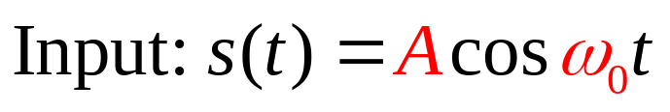



Influence of Random parameter channels on transmission
--Multipath effect(多径效应):
    The receiving signal is

Slide 35




Influence of Random parameter channels on transmission
--Multipath effect(多径效应):
    The receiving signal is
    It can be written as :

Slide 36


Influence of Random parameter channels on transmission
--Multipath effect(多径效应):
    The receiving signal is
    It can be written as :
    where --- Receiving envelope
    ---Receiving phase
缓慢随机变化
缓慢随机变化
Narrowband signal

Slide 37




Influence of Random parameter channels on transmission
--Multipath effect(多径效应):
Transmitting
Receiving
waveform
Spectrum
Conclusion: When a constant amplitude single tone sine wave propagates to the receiver over n paths, the received signal can be regarded as a narrowband signal with random varying envelope and phase. Its spectrum is diffused (弥散)

Slide 38
Influence of Random parameter channels on transmission
--Multipath effect(多径效应):
Transmitting
Receiving
waveform
Spectrum
This envelope fluctuation is called fast fading 快衰落
— the fading period is comparable to the symbol period.
i.e. fading period≈ symbol period

Slide 39


Influence of Random parameter channels on transmission
--Multipath effect(多径效应): ——简化场景： 只有两条传播路径
n=2
    A f(t ➖ τ₀)
    A f(t ➖ τ₀ ➖ τ)
F(ω)
    f(t)

Slide 40

Influence of Random parameter channels on transmission
--Multipath effect(多径效应): ——简化场景： 只有两条传播路径
n=2
    A f(t ➖ τ₀)
    A f(t ➖ τ₀ ➖ τ)
F(ω)
    f(t)
Discuss？

Slide 41

Influence of Random parameter channels on transmission
--Multipath effect(多径效应): ——简化场景：只有两条传播路径
Fixed time delay
Constant attenuation
欧拉公式
Since this fading depends on frequency, it is often referred to as frequency-selective fading（ 频率选择性衰落）.

Slide 42
Influence of Random parameter channels on transmission
--Multipath effect(多径效应): ——简化场景：只有两条传播路径
Fixed time delay
Constant attenuation
欧拉公式
In mobile 4G and 5G communications, this frequency-selective fading has a great impact on signals and degrades communication quality. So we need ways to solve this problem.

Slide 43

Condition for frequency‑selective fading

Slide 44

Example

Slide 45


